Slide 1

Job Title Benchmarking with Collective Multi-View Representation Learning
Denghui Zhang¹, Junming Liu¹, Hengshu Zhu², Yanchi Liu¹,
Lichen Wang³, Pengyang Wang⁴, Hui Xiong¹
¹Rutgers University, ²Baidu Inc, ³Northeastern University, ⁴University of Central Florida

Slide 2
Outline
Introduction
Job Graph Construction and Refinement
Collective Multi-view Representation Learning
Experimental Results

Slide 3
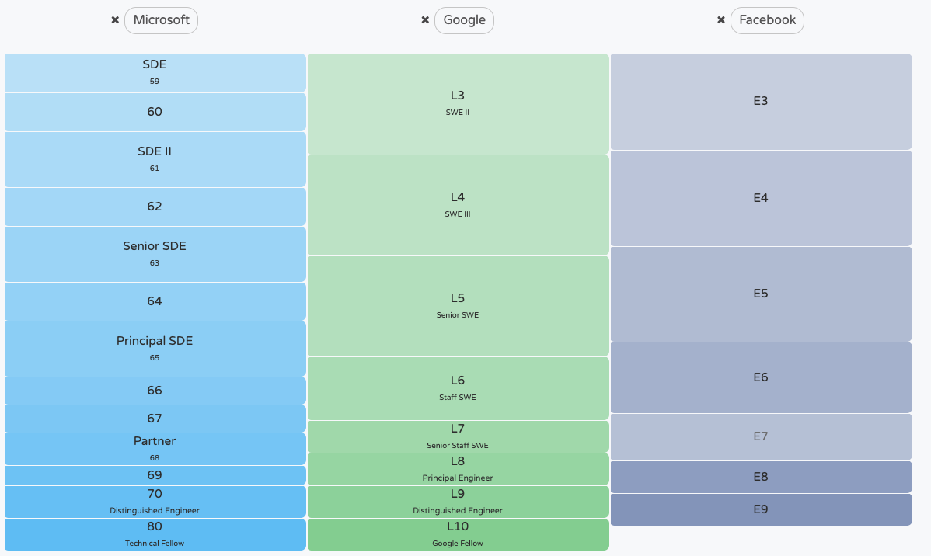
Introduction
Job Tile Benchmarking
Definition: Job title benchmarking (JTB) aims at matching job titles with similar expertise levels across various companies.
Applications of JTB:
Talent recruitment
Salary Calibration
Job recommendation
Figure 1: An example of JTB in IT industry.
https://levelsfyi.com/
Notes:
Job title benchmarking (JTB) aims at matching job titles with similar expertise levels across various companies.
The applications of JTB includes: Talent recruitment, Salary Calibration , Job recommendation and so on.
Here is an example of JTB in IT industry, which is an online survey provided by https://levelsfyi.com/.

Slide 4
Introduction
Traditional JTB relies heavily on market surveys, which are expensive and labor intensive.
Recently, the emergence of Online Professional Network (OPN) helped to accumulate a large number of career records, which provide an unparalleled opportunity for a new paradigm of JTB.
Figure 2: Multiple individuals‘ job transitions collected from LinkedIn, a major OPN provider.
Notes:
Traditional JTB relies heavily on market surveys, which are expensive and labor intensive.
Nowadays, the emergence of Online Professional Network (OPN) helped to accumulate a large number of career records, which provide an unparalleled opportunity for a new paradigm of JTB.
Figure 2 shows multiple individuals’ job transitions collected from LinkedIn.

Slide 5
Introduction
Framework Overview
Collect career profiles
Extract and aggregate job titles, build Job Graph
Multi-view representation learning for nodes on Job Graph
Perform link prediction using the representations to enrich Job Graph
Figure 3: Framework overview of our JTB approach
Notes:
We propose a framework for job title benchmarking based on the online professional data.
First is to collect career profiles, then we aggregate job titles and build the Job Graph which can provide job matching results.
For further refinement, we propose a multi-view representation learning methods based on which we perform link prediction to enrich the Job Graph.

Slide 6
Job Graph Construction and Refinement
Build a job transition graph – Job Graph
Figure 4: In Job Graph, nodes represent job titles and edges represent observed transitions between job titles.
Voting to match using Job Graph
Tile A | Title B
Software Engineer-LinkedIn | Software Engineer-Google
Staff Software Engineer-IBM | Senior Member Technical Staff-Oracle
Notes:
Here is an snapshot of Job Graph. In Job Graph, nodes represent job titles, edges represent transitions between job titles, and the weight of an edge represents the number of transitions between job titles.
Once we get Job Graph, we use voting to match to extract benchmarking results.

Slide 7
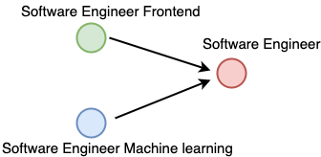







Job Graph Construction and Refinement
Problems with Job Graph
Redundancy: The the large-scale OPN data are messy and redundant because of the subjective non-standard naming convention for the same job title.
Sparsity: Job Graph is sparse due to its incompleteness, i.e., transitions which should exist but are missing or unobserved. Consequently only limited JTB results can be extracted.
Figure 5: Redundant job titles
Software Engineer
Senior
Staff
Project
Leader
Technical Lead
Figure 6: Sparsity due to missing transitions.
Notes:
However, there are two problems with the Job Graph.
First, redundancy: The the large-scale OPN data are messy and redundant because of the subjective non-standard naming convention for the same job title.
Second, Job Graph is sparse due to its incompleteness, i.e., transitions which should exist but are missing or unobserved. Consequently only limited JTB results can be extracted.

Slide 8
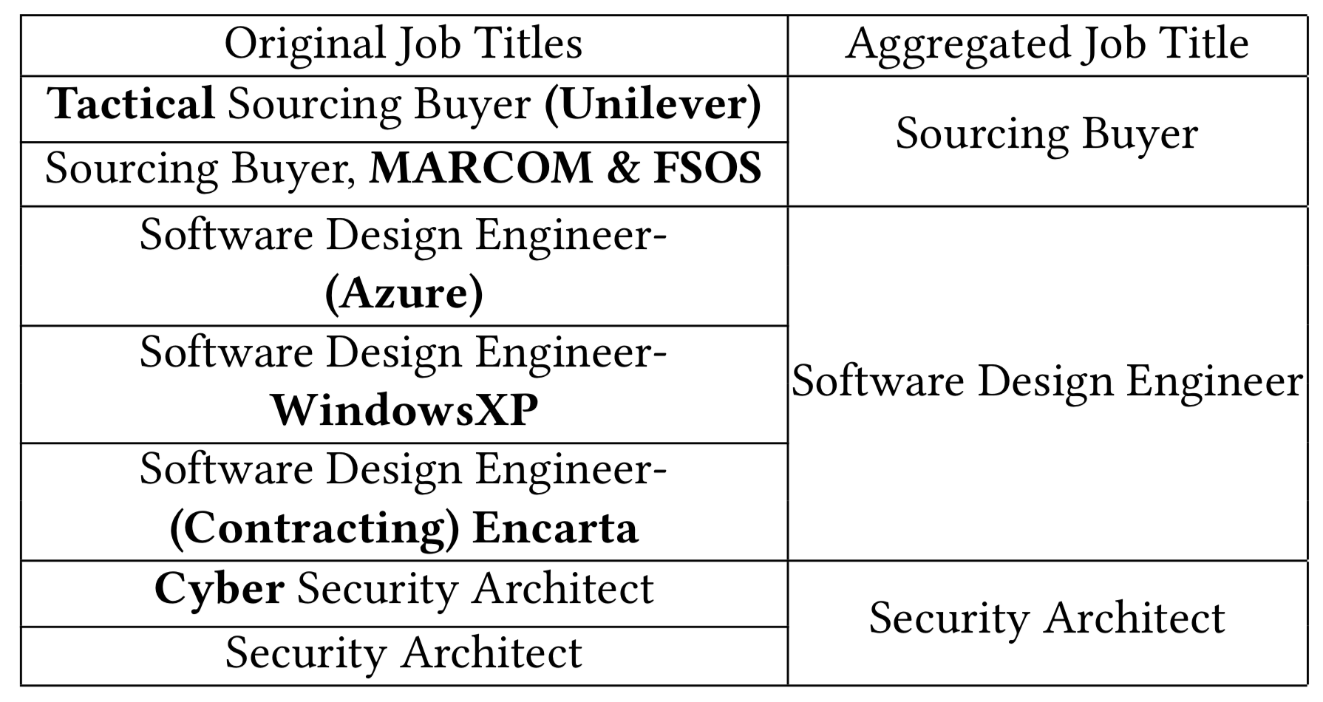
Job Graph Construction and Refinement
Job Graph Refinement: Eliminating redundancy
The word frequency distribution subjects to power law distribution. The most representative words to distinguish a title are the high frequency words.
Figure 7: Word frequency distribution of job titles.
Table 1: Examples of aggregating job titles.
Noise words or those extra descriptions usually appear in the long tail. Filtering low-frequency words can aggregate titles without changing the title core function.
Notes:
To eliminate redundancy, we propose a simple filtering method. We observed that word frequency of job title subjects to power law distribution, and the most representative words to distinguish a title are the high frequency words.
Filtering low-frequency words can aggregate titles without changing the title core function. Table 1 are three examples of this.

Slide 9
Collective Multi-view Representation Learning
Multi-view representation learning for link prediction
Learn each single view representations independently.
Ensemble different view representations by concatenating them.
Fuse different views by feeding the concatenated representation into an fusion encoder and restore the representation via a fusion decoder.
The intermediate representation (output by encoder) is the final representation we use for link prediction.
Figure 8: Architecture of Job2Vec
Notes:
To fully utilize the information in Job Graph, we propose a collective multi-view representation learning method, Job2Vec.
Job2Vec first learns each single view representation independently.
Different view representations are ensembled by concatenating.
Then we fuse different views by feeding the concatenated representation into an fusion encoder and restore the representation via a fusion decoder.
After one epoch, we re-train each single view based on the dispatched representations and repeat the process again.
The intermediate representation (output by encoder) is the final representation we use for link prediction.

Slide 10
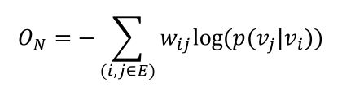
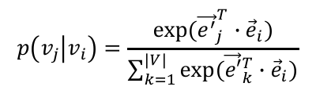
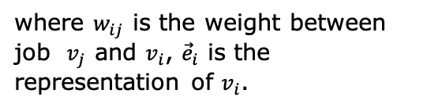
Collective Multi-view Representation Learning
Graph Topology View
Intuition:
The topology structure of Job-Graph reveal the connectivity and neighbor information of job titles which can help to describe the latent structures among job titles.
$$O_{N}=−\sum_{(i,j∈E)}{w_{ij}log⁡(p(v_{j}|v_{i}))}$$
$$p\left(v_{j} | v_{i}\right)=\frac{exp⁡({\vec{e^{′}}}_{j}^{T}∙{\vec{e}}_{i})}{\sum_{k=1}^{\left|V\right|}{exp⁡({\vec{e′}}_{k}^{T}∙{\vec{e}}_{i})}}$$
where $w_{ij}$ is the weight between job $v_{j}$ and $v_{i}$, ${\vec{e}}_{i}$ is the representation of $v_{i}$.
Figure 8: Collective Multi-View Representation Learning
Notes:
The topology structure of Job-Graph reveal the connectivity and neighbor information of job titles which can help to describe the latent structures among job titles.
To preserve the topology structure, we adopt a loss function similar to the second-order proximity loss in LINE.

Slide 11
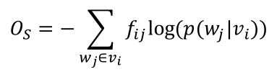
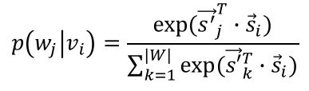
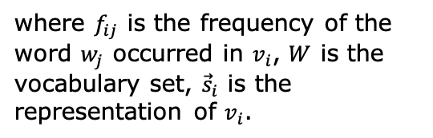
Collective Multi-view Representation Learning
Semantic View
Intuition:
Semantic information of job titles can reveal the function similarity between job titles, thus should be preserved in the representation.
$$O_{S}=−\sum_{w_{j}∈v_{i}}{f_{ij}log⁡(p(w_{j}|v_{i}))}$$
$$p\left(w_{j} | v_{i}\right)=\frac{exp⁡({\vec{s^{′}}}_{j}^{T}∙{\vec{s}}_{i})}{\sum_{k=1}^{\left|W\right|}{exp⁡({\vec{s′}}_{k}^{T}∙{\vec{s}}_{i})}}$$
where $f_{ij}$ is the frequency of the word $w_{j}$ occurred in $v_{i}$, $W$ is the vocabulary set, ${\vec{s}}_{i}$ is the representation of $v_{i}$.
Figure 8: Collective Multi-View Representation Learning
Notes:
Semantic information of job titles can reveal the function similarity between job titles, thus should be preserved in the representation.
The loss function of semantic view aims to make job titles that share similar words to have close representations.
where $f_{ij}$ is the frequency of the word $w_{j}$ occurred in $v_{i}$, $W$ is the vocabulary set, ${\vec{s}}_{i}$ is the representation of $v_{i}$.

Slide 12
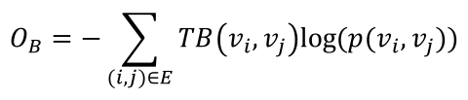
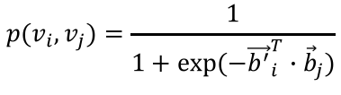
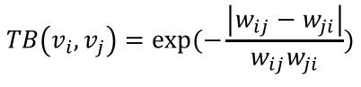
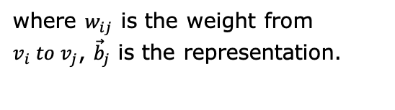
Collective Multi-view Representation Learning
Job Transition Balance View
Intuition:
The numbers of bidirectional transitions between two similar-level jobs are close. Thus the Transition Balance (TB) should be preserved.
$$TB\left(v_{i},v_{j}\right)=exp⁡(−\frac{\left|w_{ij}−w_{ji}\right|}{w_{ij}w_{ji}})$$
$$O_{B}=−\sum_{(i,j)∈E}{TB\left(v_{i},v_{j}\right)log⁡(p(v_{i},v_{j}))}$$
$$p(v_{i},v_{j})=\frac{1}{1+exp⁡(−{\vec{b^{′}}}_{i}^{T}∙{\vec{b}}_{j})}$$
where $w_{ij}$ is the weight from $v_{i} to v_{j}$, ${\vec{b}}_{j}$ is the representation.
Figure 8: Collective Multi-View Representation Learning
Notes:
The numbers of bidirectional transitions between two similar-level jobs are close. Thus the Transition Balance (TB) should be preserved.
We define Transition Balance as the exponent of normalized difference between the bidirectional transitions.
The loss function here aims to make job titles that have high Transition Balance to have close representations.

Slide 13
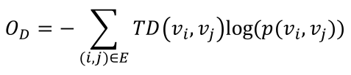
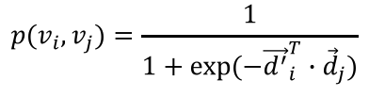
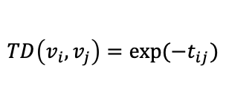
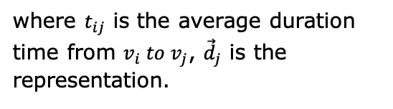
Collective Multi-view Representation Learning
Job Transition Duration View
Intuition:
The shorter the average duration of transitions is, the more similar the job titles are. Thus the transition duration should be preserved.
$$TD\left(v_{i},v_{j}\right)=exp⁡(−t_{ij})$$
$$O_{D}=−\sum_{(i,j)∈E}{TD\left(v_{i},v_{j}\right)log⁡(p(v_{i},v_{j}))}$$
$$p(v_{i},v_{j})=\frac{1}{1+exp⁡(−{\vec{d^{′}}}_{i}^{T}∙{\vec{d}}_{j})}$$
where $t_{ij}$ is the average duration time from $v_{i} to v_{j}$, ${\vec{d}}_{j}$ is the representation.
Figure 8: Collective Multi-View Representation Learning
Notes:
Most people require a relatively long time (e.g., one or several years) to get a promotion. In contrast, if a person can change his/her jobs quickly and frequently, then there are high possibilities that these jobs are similar titles requires similar expertise and working expe- rience. Make a long story short, the shorter the average duration of transitions is, the more similar the job titles are. To this end, we define Job Transition Duration which is the average duration time between two job titles.
The shorter the average duration of transitions is, the more similar the job titles are. Thus the transition duration should be preserved.
we define TD as the exponent of the minus average duration time between two job titles.
The loss function will enforce job titles that have shorter duration to have close representations.

Slide 14
Collective Multi-view Representation Learning
Training procedure:
We first train 4 different views independently to obtain 4 representations.
Then ensemble 4 views to train the auto-encoder.
Dispatch the fused representation to obtain 4 representations.
Retrain 4 views based on the representations of step 3.
Repeat step 2~4.
Figure 8: Collective Multi-View Representation Learning
Notes:
The training procedure of Job2Vec is as follows:
We first train 4 different views independently to obtain 4 representations.
Then ensemble 4 views to train the auto-encoder.
Dispatch the fused representation to obtain 4 representations.
Retrain 4 views based on the representations of step 3.
Repeat step 2~4.

Slide 15
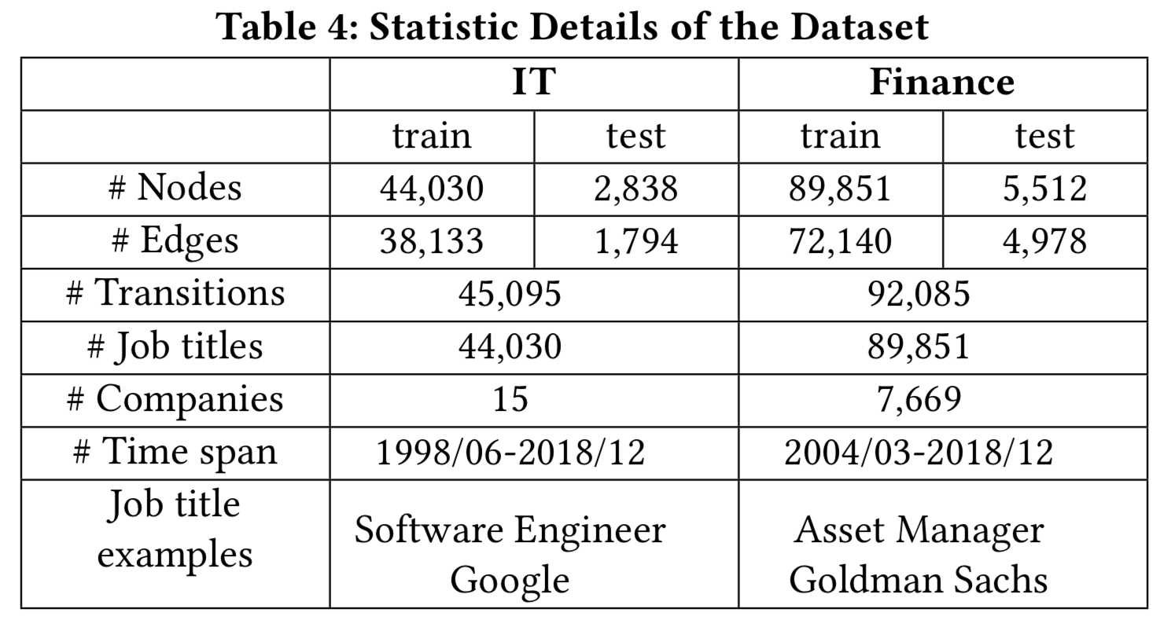
Experiments
Experiment Setup
Datasets
- IT
- Finance
Baselines
- Deepwalk
- Node2Vec
- LINE(1st order)
- LINE(1st+2nd order)
- Word2vec
Evaluation Metric
- MRR(Mean Reciprocal Rank)
- MP@K(Mean Precision@K)
Table 2: Statistic Details of the Dataset
Notes:
We conducted experiments on 2 real-word datasets, namely, IT and Finance datasets, each represent a typical industry.
We collect these two datasets from LinkedIn.
Table 2 shows the statistics of the datasets.
We compare our model with 5 baselines,
Deepwalk Node2Vec LINE(1st order) LINE(1st+2nd order) Word2vec
We adopt two evaluation metrics, Mean Reciprocal Rank and Mean Precision@K

Slide 16
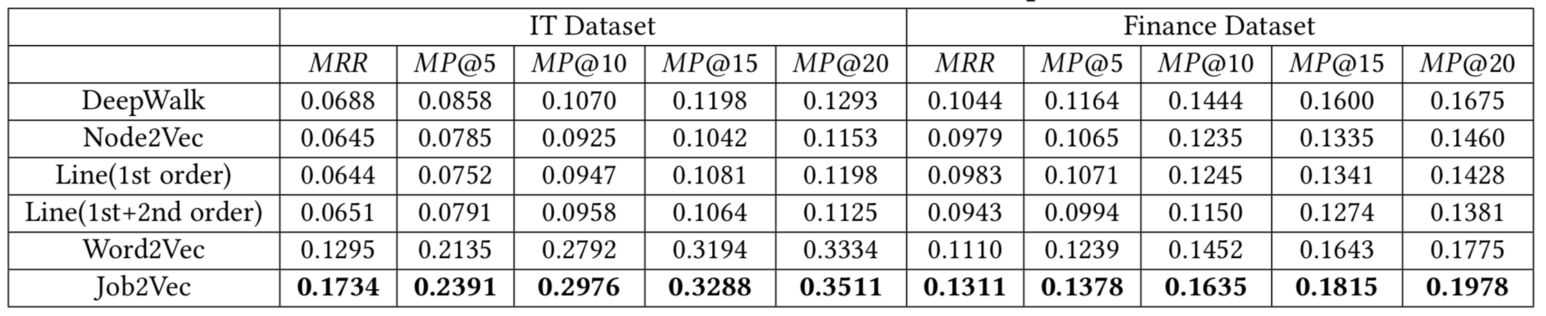
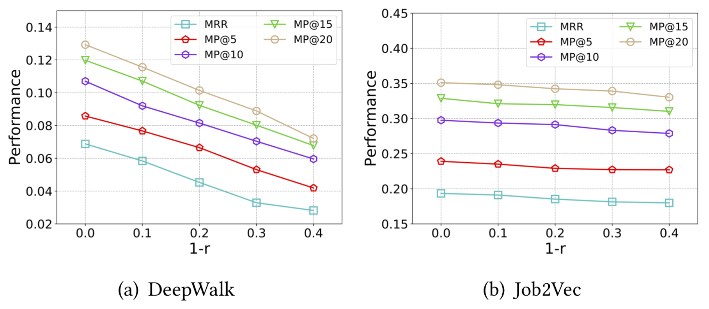
Experiments
Quantitative results
Table 3: Link prediction performance comparison on two datasets
Figure 9: Robustness Comparison
Notes:
It can be observed that network embedding based method have the poorest performance. Word2vec achieved better performance indicates that single semantic view is more important than topology view in our task.
Our model, combined four views, outperforms all the baselines, proved the effectiveness of our multi-view learning method.
We also randomly down-sample the Job Graph to make it sparser to compare the robustness of our model and other baselines. Our method has better robustness.

Slide 17
Experiments
Ablation studies
Table 4: Ablation studies
 | IT Dataset |  | Finance Dataset
 | MRR | MP@5 | MRR | MP@5
-Network | 0.1496 | 0.2086 | 0.1206 | 0.1238
-Semantic | 0.0812 | 0.1146 | 0.1047 | 0.1187
-Balance | 0.1511 | 0.2136 | 0.1215 | 0.1257
-Duration | 0.1523 | 0.2145 | 0.1221 | 0.1245
Concatenate | 0.1622 | 0.2312 | 0.1251 | 0.1298
Job2Vec | 0.1734 | 0.2391 | 0.1311 | 0.1378
Notes:
In order to validate the effectiveness of each component and the multi-view fusion, we also conducted ablation studies.
In Table 4, we show the results of removing different views and the results of simply concatenating 4 views. It can be seen that results drop when removing no matter which view, which means each view contributes to the final results.
Job2vec outperforms simply concatenating 4 views, indicate the proposed multi-view fusion method is better at learning a unified representation from multiple views.

Slide 18
Experiments
Embedding Visualization
LINE-1st
LINE-1+2
Node2vec
Deepwalk
word2vec
Job2vec (ours)
Figure 10: Visualization of the learned representations
Notes:
We visualize the learned representations to show the promising benchmarking results of our proposed model.
For convenience, we select four categories of job title representations, including engineer, sales, consultant and manager.
We randomly sampled 1000 job titles for each categories. We utilize t-SNE [16] to reduce the representation dimensions to do the visualization.
Each color corresponds to one category of job titles.
Figure 10 shows that our proposed Job2Vec achieves the best results. Each category of representations learned by our model can be clustered into four groups very well.

Slide 19
Thank you !

